Slide 1
Reinforcement Learning Curriculum
Q-Learning
Deep Q-Learning
Environment Design
Ek-1: Artificial Neural Networks (ANN)
Ek-2: Object Oriented Programming (OOP)
Ek-3: Convolutional Neural Networks (CNN)

Slide 2
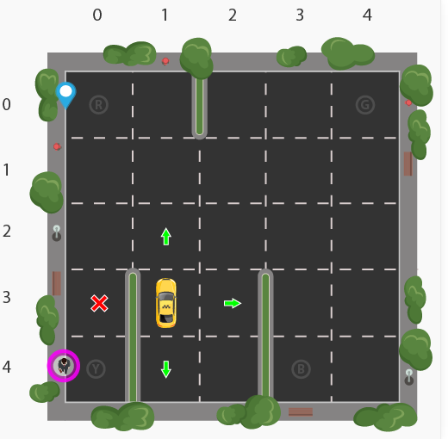
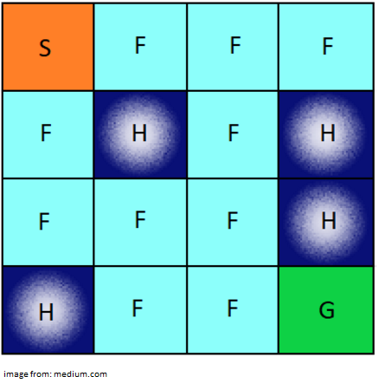
Projects

Slide 3
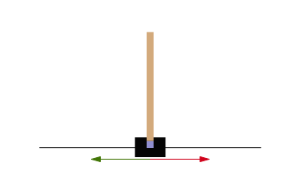
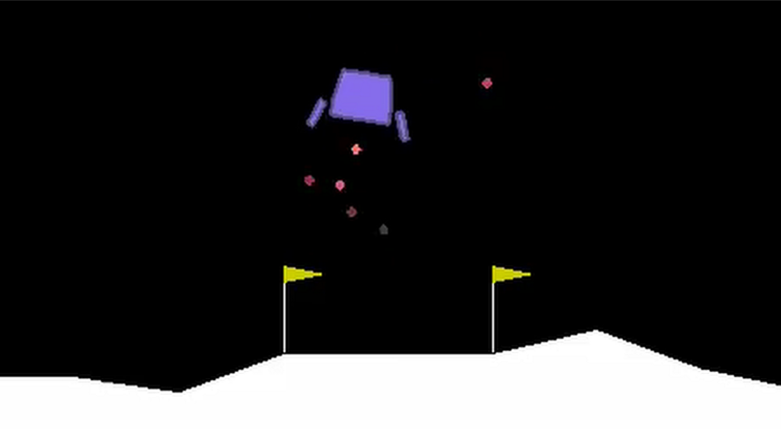
Projects

Slide 4
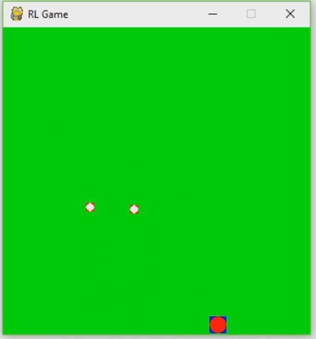
Projects

Slide 5

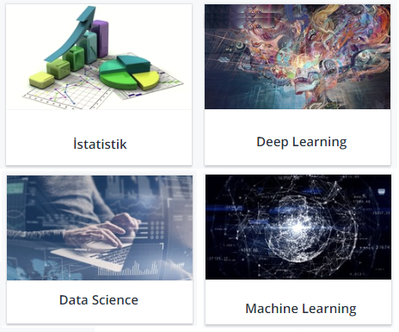

Slide 6
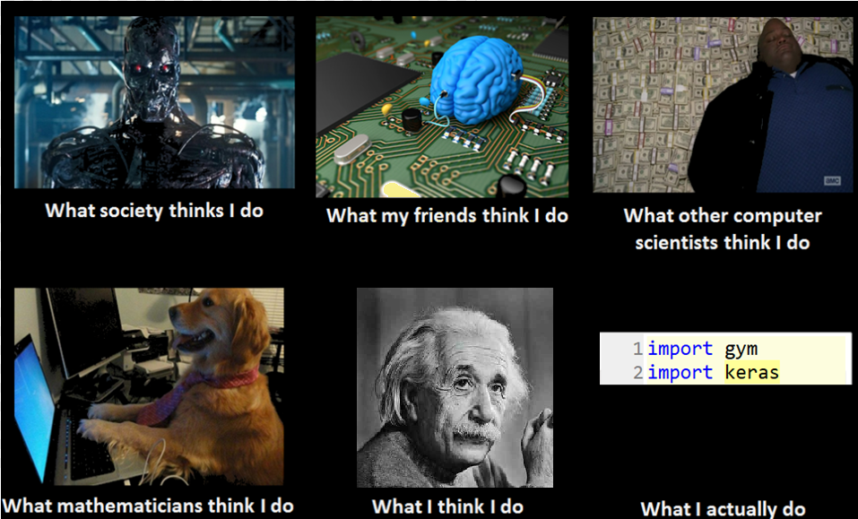

Slide 7
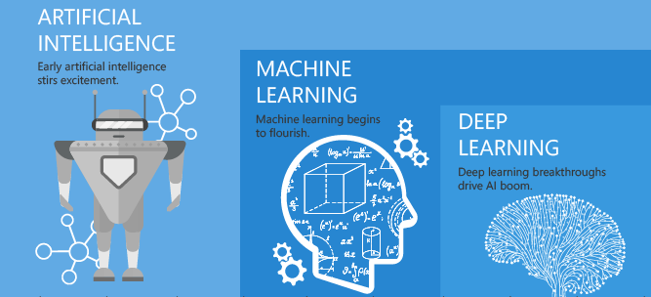
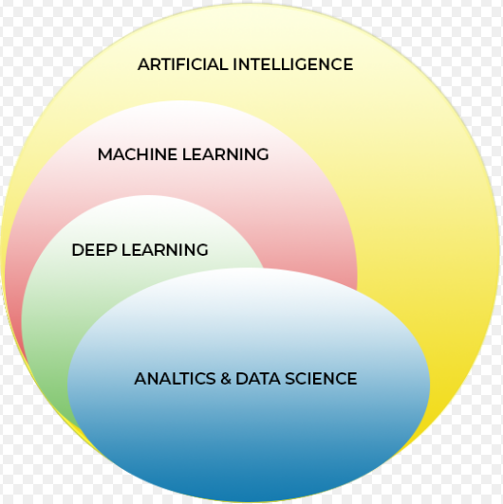

Slide 8
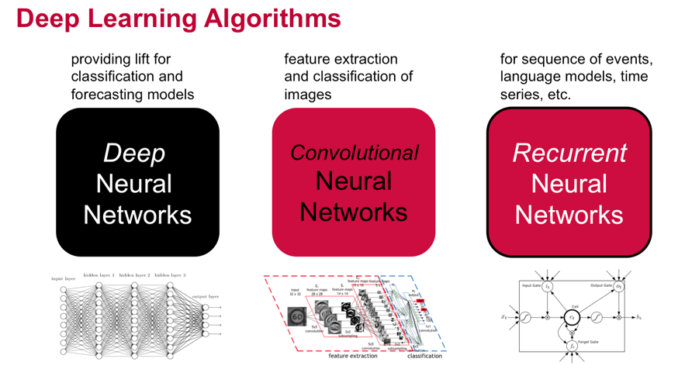

Slide 9
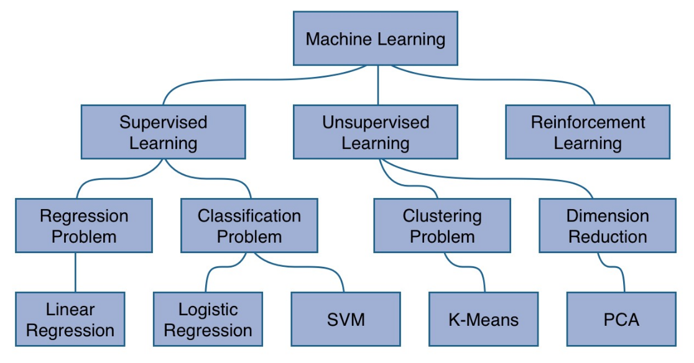

Slide 10
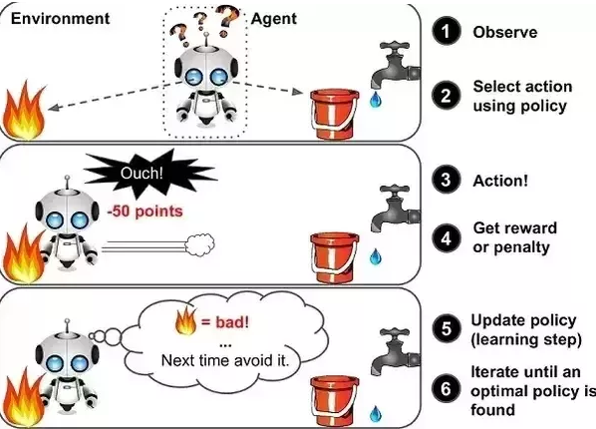

Slide 11
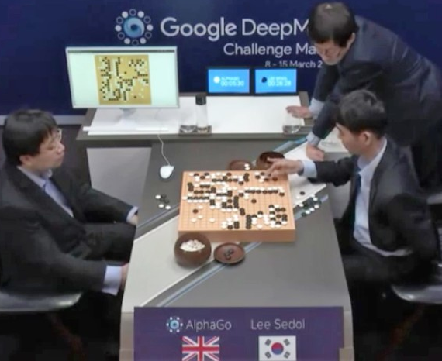
Alpha go

Slide 12
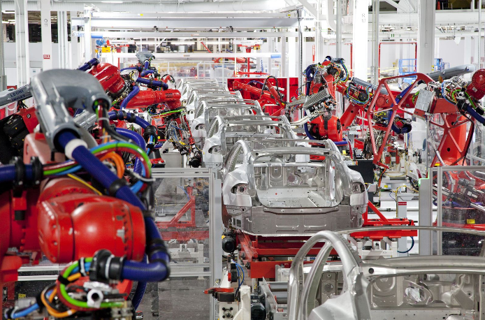
Manufacturing

Slide 13
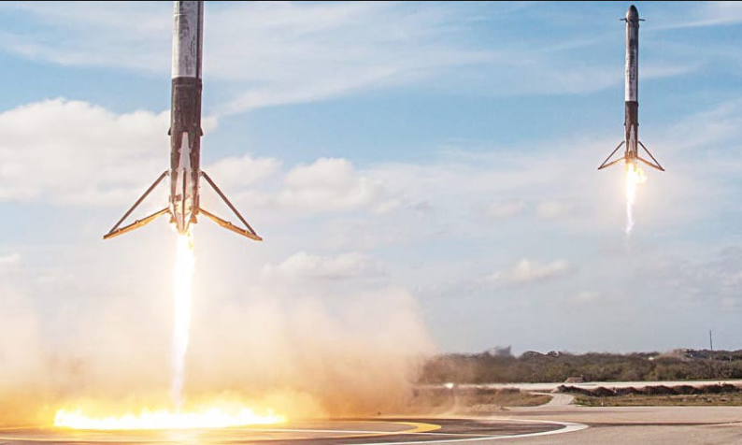
Landing a Rocket

Slide 14
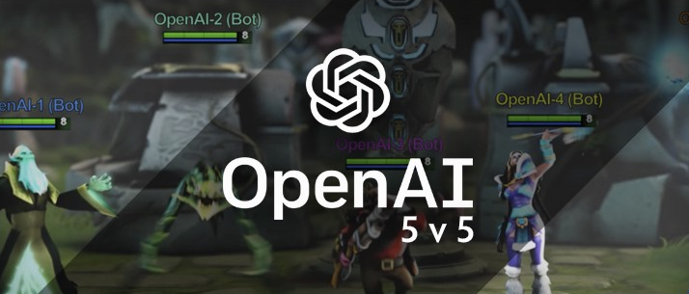
OpenAI-5

Slide 15
Anaconda & Python Packages
Anaconda
Gym
Keras
Pygame
Pybox2d

